Slide 1
Data Analyst Internship Portfolio

Slide 2
About Me
BTech student with interest in Data Analytics
Basic knowledge of Python and programming
Passionate about solving real-world problems using data
Interested in data visualization and insights

Slide 3
Internship Overview
Worked on real-world data analysis projects
Learned complete data analysis workflow
Hands-on experience in:
Data Cleaning
Data Analysis
Visualization
Statistical Techniques

Slide 4
Project 1 – Data Wrangling
Cleaned customer purchase dataset
Handled missing values and duplicates
Converted data types (date format)
Created new feature: Age Group
Tools: Python, Pandas

Slide 5
Project 2 – EDA & Business Intelligence
Analyzed Superstore dataset
Identified sales and profit trends
Created visualizations (charts & graphs)
Solved business questions using SQL
Key Insight: High sales ≠ High profit

Slide 6
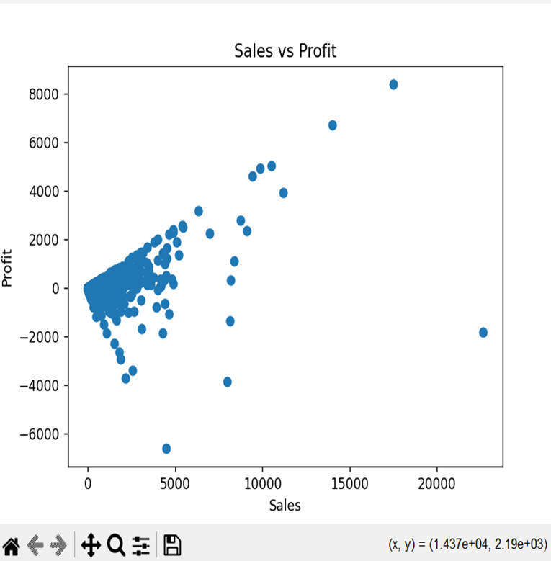
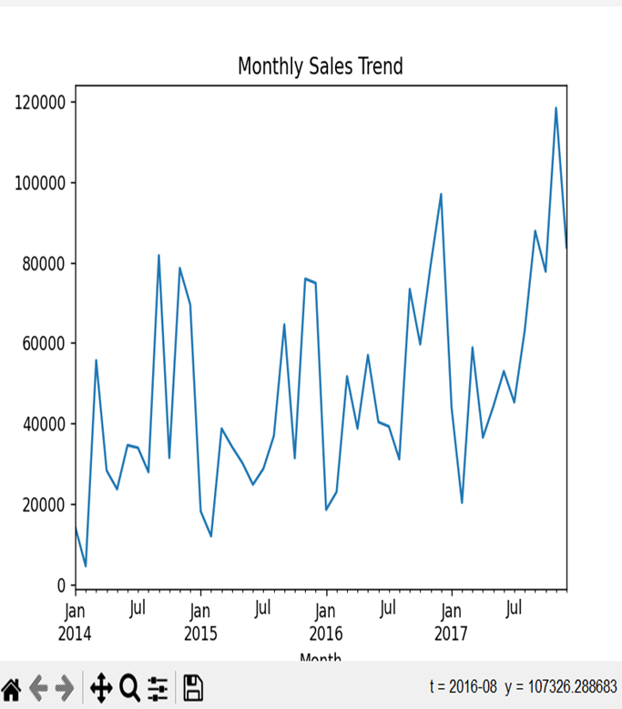

Slide 7
Project 3 – Trader Behavior Analysis
Analyzed trading performance using sentiment data
Compared Fear vs Greed market conditions
Studied trading patterns and behavior
Key Insight: Better performance during Greed periods

Slide 8
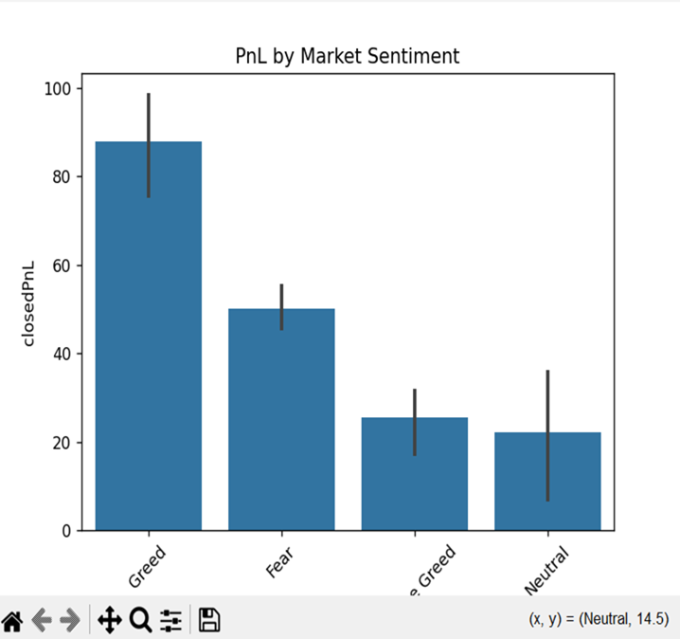
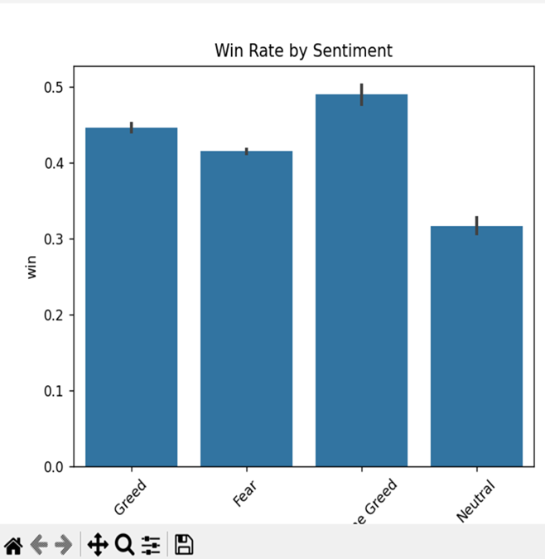

Slide 9
Project 4 – Sales Analysis & Statistics
Performed sales trend analysis
Studied relationship between sales and profit
Applied hypothesis testing (T-test)
Result: Significant difference between categories

Slide 10
Skills Gained
Python Programming
Data Analysis
Data Cleaning
Data Visualization
SQL
Statistical Analysis

Slide 11
Key Learnings
Importance of clean data
How to extract insights from data
Visualization improves understanding
Data helps in decision making

Slide 12
Conclusion
Gained practical experience in data analytics
Built multiple real-world projects
Improved problem-solving skills
Looking forward to more opportunities in data field

